Slide 1
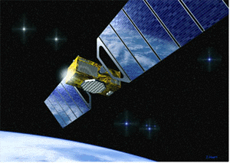
Satellite Communications
Firoz Ahmed Siddiqui

Slide 2
Satellite Communications
A Communication Satellite can be looked upon as a big microwave repeater.
It contains several transponders which listens to some portion of spectrum, amplifies the incoming signal and broadcasts it in another frequency to avoid interference with incoming signals.

Slide 3
Basics: How do Satellites Work
Two Stations on Earth want to communicate through radio broadcast but are too far away to use conventional means.
The two stations can use a satellite as a relay station for their communication
One Earth Station sends a transmission to the satellite. This is called a Uplink.
The satellite Transponder converts the signal and sends it down to the second earth station. This is called a Downlink.

Slide 4
Basics: How do Satellites Work

Slide 5
Basics: How Satellites are used
Service Types
Fixed Service Satellites (FSS)
Example: Point to Point Communication
Broadcast Service Satellites (BSS)
Example: Satellite Television/Radio
Also called Direct Broadcast Service (DBS).
Mobile Service Satellites (MSS)
Example: Satellite Phones
Notes:
The Text Book makes an odd choice in calling DBS BSS (BSS is actually the abbreviation used for Boeing Satellite Service).
These distinctions aren’t set in stone. For example, FSS satellites used to be used for broadcasting.

Slide 6
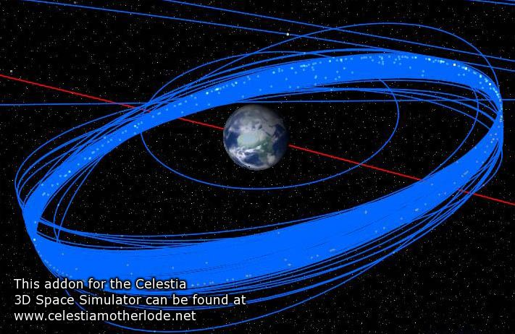
Types of Satellites
Satellite Orbits
GEO
LEO
MEO
Frequency Bands

Slide 7
Geostationary Earth Orbit (GEO)
GEO satellites are synchronous with respect to earth. Looking from a fixed point from Earth, these satellites appear to be stationary.
There are three conditions which lead to geostationary satellites.

Slide 8
GEO (cont.)
The satellite should be placed 35,786 kms (approximated to 36,000 kms) above the surface of the earth.
These satellites must travel in the rotational speed of earth, and in the direction of motion of earth, that is eastward.
The inclination of satellite with respect to earth must be 0⁰

Slide 9
GEO (cont.)
Geostationary satellite in practical is termed as geosynchronous as there are multiple factors which make these satellites shift from the ideal geostationary condition.
Gravitational pull of sun and moon makes these satellites deviate from their orbit. Over the period of time, they go through a drag. (Earth’s gravitational force has no effect on these satellites due to their distance from the surface of the Earth.)

Slide 10
GEO (cont.)
These satellites experience the centrifugal force due to the rotation of Earth, making them deviate from their orbit.
The non-circular shape of the earth leads to continuous adjustment of speed of satellite from the earth station.
These satellites are used for TV and radio broadcast, weather forecast and also, these satellites are operating as backbones for the telephone networks.

Slide 11
Low Earth Orbit (LEO)
These satellites are placed 500-1500 kms above the surface of the earth.
As LEOs circulate on a lower orbit, hence they exhibit a much shorter period that is 95 to 120 minutes.
Each LEO satellite will only be visible from the earth for around ten minutes.

Slide 12
LEO (cont.)
These satellites are mainly used in remote sensing and providing mobile communication services.
The biggest problem of the LEO concept is the need for many satellites if global coverage is to be reached.
One general problem of LEOs is the short lifetime of about five to eight years due to atmospheric drag and radiation

Slide 13
Medium Earth Orbit (MEO)
A MEO satellite is in orbit somewhere between 8,000 km and 18,000 km above the earth’s surface.
MEO satellites are similar to LEO satellites in functionality.
MEO satellites are visible for much longer periods of time than LEO satellites, usually between 2 to 8 hours.
MEO satellites have a larger coverage area than LEO satellites.

Slide 14
MEO (cont.)
Advantage
A MEO satellite’s longer duration of visibility and wider footprint means fewer satellites are needed in a MEO network than a LEO network.
Disadvantage
A MEO satellite’s distance gives it a longer time delay and weaker signal than a LEO satellite, though not as bad as a GEO satellite.

Slide 15
Frequency Bands
Different kinds of satellites use different frequency bands.
L–Band: 1 to 2 GHz, used by MSS
S-Band: 2 to 4 GHz, used by MSS, NASA, deep space research
C-Band: 4 to 8 GHz, used by FSS
X-Band: 8 to 12.5 GHz, used by FSS and in terrestrial imaging, ex: military and meteorological satellites
Ku-Band: 12.5 to 18 GHz: used by FSS and BSS (DBS)
K-Band: 18 to 26.5 GHz: used by FSS and BSS
Ka-Band: 26.5 to 40 GHz: used by FSS

Slide 16
Capacity Allocation
FDMA
FAMA-FDMA
DAMA-FDMA
TDMA
Advantages over FDMA

Slide 17
Basics: Advantages of Satellites
The advantages of satellite communication over terrestrial communication are:
The coverage area of a satellite greatly exceeds that of a terrestrial system.
Transmission cost of a satellite is independent of the distance from the center of the coverage area.
Satellite to Satellite communication is very precise.
Higher Bandwidths are available for use.

Slide 18
Basics: Disadvantages of Satellites
The disadvantages of satellite communication:
Launching satellites into orbit is costly.
Satellite bandwidth is gradually becoming used up.
There is a larger propagation delay in satellite communication than in terrestrial communication.

Slide 19
Definitions of Terms for Earth-Orbiting Satellites

Slide 20
Definitions of Terms for Earth-Orbiting Satellites
Apogee - The point farthest from earth. Apogee height is shown as ha in Fig.
Perigee - The point of closest approach to earth. The perigee height is shown as hp in Fig.
Subsatellite path - This is the path traced out on the earth’s surface directly below the satellite.

Slide 21
Definitions of Terms for Earth-Orbiting Satellites
Line of apsides - The line joining the perigee and apogee through the center of the earth.
Ascending node - The point where the orbit crosses the equatorial plane going from south to north.
Descending node - The point where the orbit crosses the equatorial plane going from north to south.

Slide 22
Definitions of Terms for Earth-Orbiting Satellites
Line of nodes - The line joining the ascending and descending nodes through the center of the earth.
Inclination - The angle between the orbital plane and the earth’s equatorial plane. It is measured at the ascending node from the equator to the orbit, going from east to north.

Slide 23
Definitions of Terms for Earth-Orbiting Satellites

Slide 24
Definitions of Terms for Earth-Orbiting Satellites
Prograde orbit - An orbit in which the satellite moves in the same direction as the earth’s rotation. The prograde orbit is also known as a direct orbit. The inclination of a prograde orbit always lies between 0°and 90°. Most satellites are launched in a prograde orbit because the earth’s rotational velocity provides part of the orbital velocity with a consequent saving in launch energy.

Slide 25
Definitions of Terms for Earth-Orbiting Satellites
Retrograde orbit - An orbit in which the satellite moves in a direction counter to the earth’s rotation, as shown in Fig. The inclination of a retrograde orbit always lies between 90°and 180°.
Argument of perigee - The angle from ascending node to perigee, measured in the orbital plane at the earth’s center, in the direction of satellite motion. The argument of perigee is shown as ω in Fig.

Slide 26
Definitions of Terms for Earth-Orbiting Satellites

Slide 27
Definitions of Terms for Earth-Orbiting Satellites
Mean anomaly - Mean anomaly M gives an average value of the angular position of the satellite with reference to the perigee. For a circular orbit, M gives the angular position of the satellite in the orbit.
True anomaly - The true anomaly is the angle from perigee to the satellite position, measured at the earth’s center. This gives the true angular position of the satellite in the orbit as a function of time.

Slide 28
Orbital Elements
Earth-orbiting artificial satellites are defined by six orbital elements referred to as the keplerian element set.
Two of these, the semimajor axis (a) and the eccentricity (e) give the shape of the ellipse.
A third, the mean anomaly M, gives the position of the satellite in its orbit at a reference time known as the epoch.

Slide 29
Orbital Elements
A fourth, the argument of perigee ω, gives the rotation of the orbit’s perigee point relative to the orbit’s line of nodes in the earth’s equatorial plane.
The remaining two elements, the inclination (i) and the right ascension of the ascending node Ω, relate the orbital plane’s position to the earth.

Slide 30
Look Angle Determination
Look Angles – The coordinates to which an earth station antenna must be pointed to communicate with a satellite are called the look angels. These are azimuth (AZ) and elevation (EI)
Azimuth (AZ) – It is measured eastward (clockwise) from geographic north to the projection of the satellite path on a horizontal plane at the earth station.

Slide 31
Look Angle Determination
Elevation (EL) – It is the angle measured upward from the local horizontal plane at the earth station to the satellite path.
The subsatellite point – The subsatellite point is the location on the surface of the earth that lies directly between the satellite and the center of the earth. It is nadir pointing direction from the satellite and, for a satellite in an equatorial orbit, it will always be located on the equator.

Slide 32
Look Angle Definition

Slide 33
Look Angle Definition

Slide 34
Look Angle Definition
To an observer of a satellite standing at the subsatellite point, the satellite will appear to the directly overhead, in the zenith direction from the observing location.
The zenith and nadir paths are therefore in opposite directions along the same path.
Designers of satellite antennas reference the pointing direction of the satellite’s antenna beams to the nadir direction.

Slide 35
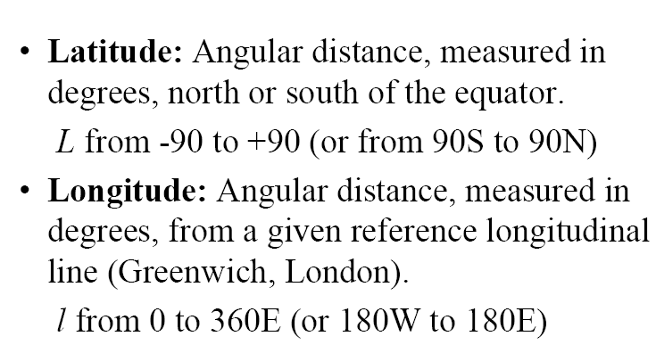
Coordinate System

Slide 36
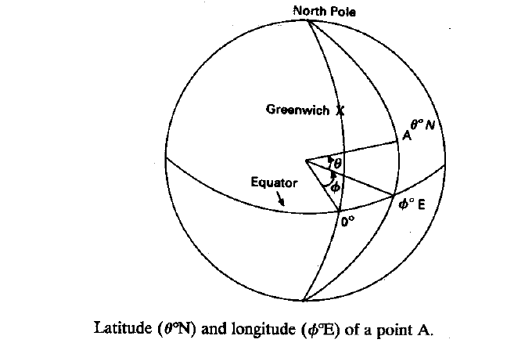
Coordinate System

Slide 37
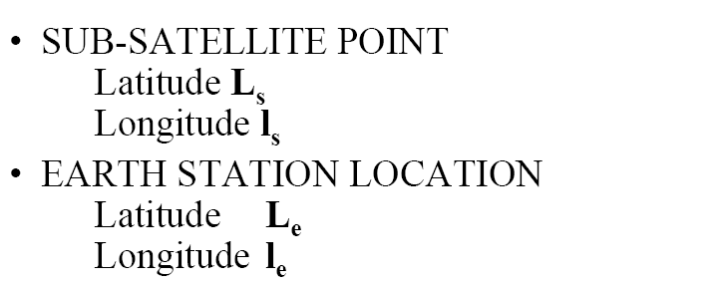
Satellite Coordinates

Slide 38
Review of Geometry

Slide 39
Elevation Angle Calculation

Slide 40
Elevation Angle Calculation
Figure shows the geometry of the elevation angle calculation.
r_{s} is the vector from the center of the earth to the satellite.
r_{e} is the vector from the center of the earth to the earth station.
d is the vector from the earth station to the satellite.
These three vectors lie in the same plane and form a triangle.

Slide 41
Elevation Angle Calculation
The central angle γ measured between $r_{e}$ and $r_{s}$ is the angle between the earth station and the satellite.
Ψ is the angle measured from $r_{e}$ to d.
γ is related to the earth station north latitude $L_{e}$ and west latitude $l_{e}$ and the subsatellite point at north latitude $L_{s}$ and west latitude $l_{s}$ by

Slide 42
Elevation Angle Calculation
$$cos\left(γ\right)=cos\left(L_{e}\right)cos\left(L_{s}\right)cos\left(l_{s}−l_{e}\right)+sin\left(L_{e}\right)sin\left(L_{s}\right)$$
--------(1)
The magnitude of the vectors joining the center of the earth, the satellite and the earth station are related by the law of cosine:
$d=r_{s}{\left[1+{\left(\frac{r_{e}}{r_{s}}\right)}^{2}−2\left(\frac{r_{e}}{r_{s}}\right)cos\left(γ\right)\right]}^{1/2}$----------(2)

Slide 43
Elevation Angle Calculation
Since the local horizontal plane at the earth station is perpendicular to $r_{e}$, the elevation angle El is related to the central angle ψ by
$El=\text{ψ}−{90}^{0}$ ---------(3)
By the law of sines we have
$\frac{r_{s}}{sin\left(\text{ψ}\right)}=\frac{d}{sin\left(γ\right)}$ ---------(4)

Slide 44
Elevation Angle Calculation
Combining the last three equation yields
$$cos\left(El\right)=\frac{r_{s} sin\left(γ\right)}{d}$$ $cos\left(El\right)=\frac{sin\left(γ\right)}{{\left[1+{\left(\frac{r_{e}}{r_{s}}\right)}^{2}−2\left(\frac{r_{e}}{r_{s}}\right)cos\left(γ\right)\right]}^{1/2}}$ --(5)
Equation (5) and (1) permit the elevation angle to be calculated from knowledge of the subsatellite point and the earth station coordinates, the orbital radius $r_{s}$, and the earth’s radius $r_{e}$.

Slide 45
Elevation Angle Calculation
Using $r_{s}=42164 km$ and $r_{e}=6378.14 km$ gives
$$d=42164{\left[1.0228826−0.3025396 cos\left(γ\right)\right]}^{1/2}km$$
Which finally gives the elevation angle
$cos\left(El\right)=\frac{sin\left(γ\right)}{{\left[1.0228826−0.3025396 cos\left(γ\right)\right]}^{1/2}}$

Slide 46
Azimuth Angle Calculation
It is more difficult to compute Azimuth angle than the elevation angle because the exact geometry involved depends on whether the subsatellite point is east or west of the earth station, and in which of the hemispheres the earth station and the subsatellite point are located.
Its calculation is some what simple for GEO satellite.

Slide 47
Azimuth Angle Calculation
Different formulas and corrections apply depending on the combination of positions of the earth station and subsatellite point with relation to each of the four quadrants (NW, NE, SW, SE).

Slide 48
Azimuth Angle Calculation for GEO Satellites
For most geostationary satellites, the subsatellite point is on the equator at longitude $l_{s}$, and the latitude $L_{s}$ is 0.
Since $L_{s}$ is zero, equation (1) simplifies to
$$cos\left(γ\right)=cos\left(L_{e}\right)cos\left(l_{s}−l_{e}\right)$$

Slide 49
Azimuth Angle Calculation for GEO Satellites
To find the azimuth angle, an intermediate angle α must first be found.
The intermediate angle α allows the correct ${90}^{0}$ quadrant to be found for the azimuth since the azimuthal angle can lie anywhere between $0^{0}$ (true north) and clockwise through ${360}^{0}$ (back to north again).
The intermediate angle is given by

Slide 50
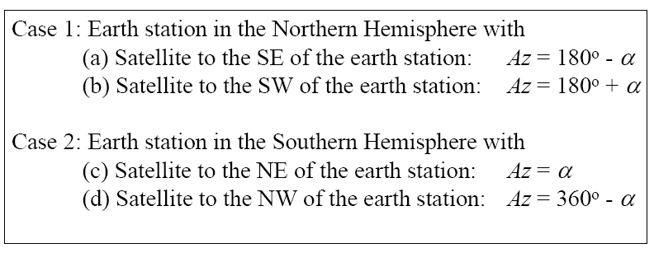
Azimuth Angle Calculation for GEO Satellites
$$α=\tan^{−1}\left[\frac{tan\left|\left(l_{s}−l_{e}\right)\right|}{sin\left(L_{e}\right)}\right]$$
After finding the intermediate angle $α$, the azimuth angle can be found from

Slide 51
Example for Look Angle Calculation of a GEO satellite
An earth station situated in the Docklands of London, England, needs to calculate the look angle to a geostationary satellite in the Indian Ocean operated by Intelsat. The details of the earth station site and the satellite are as follows:
Earth station latitude and longitude are ${52.0}^{0}$N and $0^{0}$.
Satellite longitude (subsatellite point) is ${66.0}^{0}$E.

Slide 52
Example (Contd.)
Step 1: Find the central angle γ
$$cos\left(γ\right)=cos\left(L_{e}\right)cos\left(l_{s}−l_{e}\right) \\ cos\left(γ\right)=\cos\left(52.0\right)\cos\left(66.0\right) \\ cos\left(γ\right)=0.2504 \\ γ={75.4981}^{0}$$
The central angle $γ$ is less than ${81.3}^{0}$ so the satellite is visible from the earth station.

Slide 53
Example (Contd.)
Step 2: Find the elevation angle El
$$cos\left(El\right)=\frac{sin\left(γ\right)}{{\left[1.0228826−0.3025396 cos\left(γ\right)\right]}^{1/2}} \\ cos\left(El\right)=\frac{sin\left(75.4981\right)}{{\left[1.0228826−0.3025396 cos\left(75.4981\right)\right]}^{1/2}}$$
$$El={5.847}^{0}$$

Slide 54
Example (Contd.)
Step 3: Find the intermediate angle α
$$α=\tan^{−1}\left[\frac{tan\left|\left(l_{s}−l_{e}\right)\right|}{sin\left(L_{e}\right)}\right]$$
$$α=\tan^{−1}\left[\frac{tan\left|\left(66.0−0\right)\right|}{sin\left(52.0\right)}\right] \\ α={70.667}^{0}$$

Slide 55
Example (Contd.)
Step 4: Find the azimuth angle
The earth station is in the northern Hemisphere and the satellite is to the southeast of the earth station.
$$A_{z}=180−α \\ A_{z}=180−70.667$$ $A_{z}={109.333}^{0}$(clockwise from true north)

Slide 56
Orbital Perturbation
The keplerian orbit described by Kepler is ideal as it assumes that the earth is a uniform spherical mass and that the only force acting is the centrifugal force resulting from satellite motion balancing the gravitational pull of the earth.
In practice, other forces which can be significant are the gravitational forces of the sun and the moon and atmospheric drag.

Slide 57
Orbital Perturbation
The gravitational pulls of sun and moon have negligible effect on low-orbiting satellites, but they do affect satellites in the geostationary orbit.
Atmospheric drag, on the other hand, has negligible effect on geostationary satellites but does affect low orbiting earth satellites below about 1000 km.

Slide 58
Effects of nonspherical earth
The earth is neither a perfect sphere nor a perfect ellipse. The earth is flattened at the poles, the equatorial diameter is about 20 km more than the average polar diameter.
In addition to these nonregular features of the earth, there are regions where the average density of the earth appears to be higher. These are called regions of mass concentration or Mascons.

Slide 59
Effects of nonspherical earth
A geostationary satellite is weightless when in orbit. The smallest force on satellite will cause it to accelerate and then drift away from its nominal location.
Due to the position of the Mascons and equatorial bulges, there are four equilibrium points in the geostationary orbit: two of them stable and two unstable.
The stable points are analogous to the bottom of a valley, and the unstable points to the top of a hill.

Slide 60
Effects of nonspherical earth
The satellite at an unstable orbital location is at the top of a gravity hill. Given a small force, it will drift down the gravity slope into the gravity valley and finally stay there, at the stable position.
The stable points are at about ${75}^{0}$ E and ${252}^{0}$ E and the unstable points are at around ${162}^{0}$ E and ${348}^{0}$ E.

Slide 61
Effects of Sun and the Moon

Slide 62
Effects of Sun and the Moon
The plane of the earth’s orbit around the sun (ecliptic) is at an inclination of ${7.3}^{0}$ to the equatorial plane of the sun. the earth is tilted about ${23}^{0}$ away from the normal to the ecliptic. The moon circles the earth with an inclination of $5^{0}$ to the equatorial plane of the earth.
As the various planes are different, a satellite in orbit around the earth will be subjected to a variety of out-of-plane forces.

Slide 63
Effects of Sun and the Moon
Therefore there will be a net acceleration force that is not in the plane of the satellite’s orbit, and this will tend to try to change the inclination of the satellite’s orbit from its initial inclination.
The mass of the sun is significantly larger than that of the moon but the moon is considerably closer to the earth than the sun.

Slide 64
Effects of Sun and the Moon
 | Mean radius | Mass | Mean orbit radius | Spin period
Sun | 696,000 km | 333,432 units | 30,000 light years | 25.04 earth days
Moon | 3,476 km | 0.012 units | 384,500 km | 27.3 earth days
Earth | 6,378.14 km | 1.0 units | 149,597,870 km | 1 earth day
The orbit radius refers to the center of the home galaxy (Milky Way) for the sun, center of earth for the moon, and center of the sum for the earth respectively

Slide 65
Effects of Sun and the Moon
For this reason, the acceleration force induced by the moon on a geostationary satellite is about twice as large as that of the sun.
The net effect of the acceleration forces induced by the moon and the sun on a geostationary satellite is to change the plane of the orbit at an initial average rate of change of ${0.85}^{0}$/year from the equatorial plane.

Slide 66
Effects of Sun and the Moon
When both the sun and moon are acting on the same side of the satellite’s orbit, the rate of change of the plane of the geostationary satellite’s orbit will be higher than the average.
When they are on opposite sides of the orbit, the rate of change of the plane of the satellite’s orbit will be less than average.

Slide 67
Effects of Sun and the Moon
Examples of maximum years are 1988 and 2006 (${0.94}^{0}$/year) and examples of minimum years are 1997 and 2015 (${0.75}^{0}$/year).
These rate of change are at maximum when the inclination is zero and they are zero when the inclination is ${14.67}^{0}$.
From an initial zero inclination, the plane of the geostationary orbit will change to a maximum inclination of ${14.67}^{0}$ over 26.6 years.

Slide 68
Atmospheric Drag
For Low Earth orbiting satellites, the effect of atmospheric drag is more pronounces. The impact of this drag is maximum at the point of perigee. Drag (pull towards the Earth) has an effect on velocity of Satellite (velocity reduces).
This causes the satellite to not reach the apogee height successive revolutions. This leads to a change in value of semi-major axis and eccentricity. Satellites in service are maneuvered by the earth station back to their original orbital position.

Slide 69
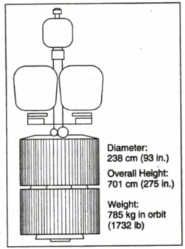
Satellite Subsystems

Slide 71
Attitude and Orbit Control System (AOCS)
This subsystem consists of rocket motors that are used to move the satellite back to the correct orbit when external forces causes it to drift off and gas jets that control the attitude of the satellite.
The attitude and orbit of a satellite must be controlled so that the satellite’s antennas point toward the earth and so that the user knows where in the sky to look for the satellite.

Slide 72
(AOCS) Contd.
Solar pressure acting on a satellite’s solar sails and antennas, and the earth’s magnetic field generating eddy current in the satellite’s metallic structure as it travels through the magnetic field.
This will cause rotation of the satellite body.

Slide 73
Attitude Control System
There are two ways to make a satellite stable in orbit, when it is weightless.
The body of the satellite can be rotated at a rate between 30 and 100 rpm, to create a gyroscopic force that provides stability of the spin axis and keeps it pointing in the same direction. Such satellites are known as spinners.
Example: Hughes 376 satellite.

Slide 74
Attitude Control System
The satellite can be stabilized by one or more momentum wheels.
The momentum wheel is usually a solid metal disk driven by an electric motor.
Increasing the speed of the momentum wheel causes the satellite to process in the opposite direction.
Example: Hughes 701 series.

Slide 75
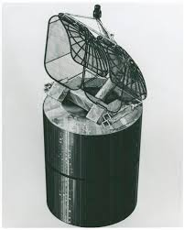
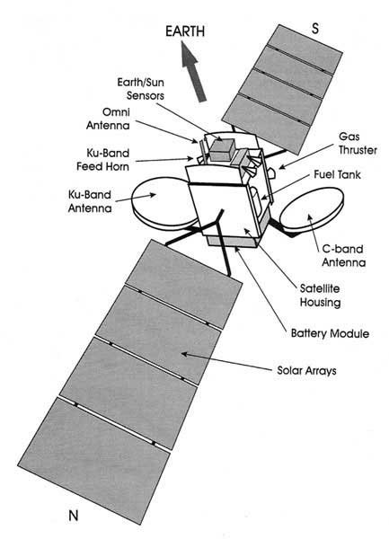

Slide 76
Orbit Control System
A geostationary satellite is subjected to several forces that tend to accelerate it away from its required orbit.
The gravitation forces of the moon and the sun cause inclination of the orbital plane and the nonspherical shape of the earth around the equator, which causes drift of the subsatellite point.

Slide 77
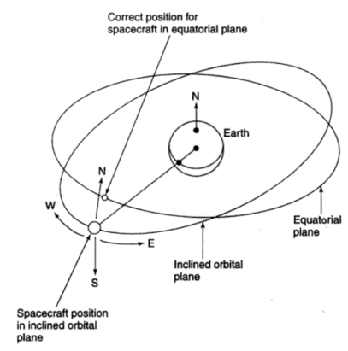
Orbit Control System

Slide 78
Orbit Control System
Fig. shows a diagram of an inclined orbital plane close to the geostationary orbit.
For the orbit to be truly geostationary, it must lie in the equatorial plane, be circular, and have the correct altitude.
The function of the orbit control system to return it to the correct orbit.

Slide 79
Orbit Control System
If the orbit is not circular, a velocity increase or decrease will have to be made along the orbit.
On a spinning satellite, this is achieved by pulsing the radial jets when they point along the X axis.
On a three-axis stabilized satellite, there will usually be two pairs of X-axis jets acting in opposite directions

Slide 80
Orbit Control System
The orbit of a geostationary satellite remains approximately circular for long periods of time and does not need frequent velocity corrections to maintain circularity.
Altitude corrections are made by operating the Z-axis gas jets.

Slide 81
Telemetry, Tracking, Command, and Monitoring (TTC&M)
The TTC&M system is essential to the successful operation of a communications satellite.
The main functions of satellite management are to control the orbit and attitude of the satellite, monitor the status of all sensors and subsystems on the satellite, and switch on or off sections of the communication system.

Slide 82
Telemetry and Monitoring System
The monitoring system collects data from many sensors within the satellite and sends these data to the controlling earth station.
There may be several hundred sensors located on the satellite to monitor pressure in the fuel tanks, voltage and current in the power conditioning unit, current drawn by each subsystem.

Slide 83
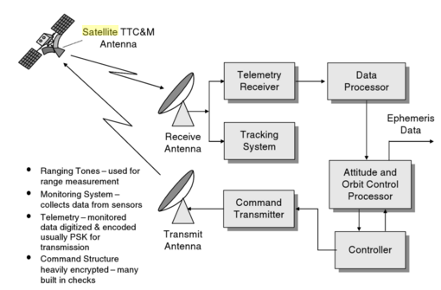

Slide 84
Tracking
A number of techniques can be used to determine the current orbit of a satellite.
Velocity and acceleration sensors on the satellite can be used to find the change in orbit from the last known position.
The earth station controlling the satellite can observe the Doppler shift of the telemetry carrier or beacon transmitter carrier to determine the rate at which range is changing.

Slide 85
Tracking
Active determination of range can be achieved by transmitting a pulse, or sequence of pulses, to the satellite and observing the time delay before the pulse is received again.

Slide 86
Command
A secure and effective command structure is vital to the successful launch and operation of any communications satellite.
The command system is used to make changes in attitude and corrections to the orbit and to control the communication system.
During the launch, it is used to control the firing of the apogee kick motor and to spin up a spinner or extend the solar sails and antennas of a three-axis stabilized satellite.

Slide 87
Communication Subsystems
A communication satellite exists to provide a platform in geostationary orbit for the relaying of voice, video, and data communications.
All other subsystems on the satellite exist to support the communications sytem.

